Slide 1
Virtual Machine Project
Sulaiman Jalloh
Notes:
This template can be used as a starter file to give updates for project milestones.
Sections
Right-click on a slide to add sections. Sections can help to organize your slides or facilitate collaboration between multiple authors.
Notes
Use the Notes section for delivery notes or to provide additional details for the audience. View these notes in Presentation View during your presentation.
Keep in mind the font size (important for accessibility, visibility, videotaping, and online production)
Coordinated colors
Pay particular attention to the graphs, charts, and text boxes.
Consider that attendees will print in black and white or grayscale. Run a test print to make sure your colors work when printed in pure black and white and grayscale.
Graphics, tables, and graphs
Keep it simple: If possible, use consistent, non-distracting styles and colors.
Label all graphs and tables.

Slide 2
Project Overview
Run a set of commands from a txt file
Make it user friendly
Have a code well organized and easy to understand
Notes:
What is the project about?
Define the goal of this project
Is it similar to projects in the past or is it a new effort?
Define the scope of this project
Is it an independent project or is it related to other projects?
* Note that this slide is not necessary for weekly status meetings

Slide 3
Current Status
New adds and changes since last presentation
Two programs in one
Two functions to make it easier to address possible problems
Deadlines will be met by Friday 7 2014
Notes:
* If any of these issues caused a schedule delay or need to be discussed further, include details in next slide.

Slide 4
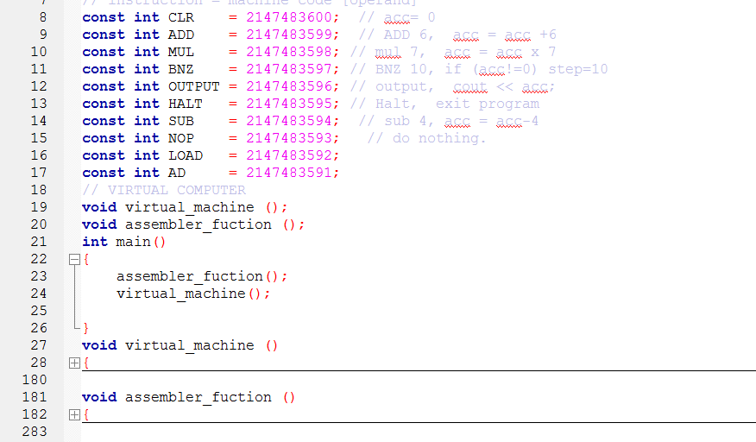

Slide 5
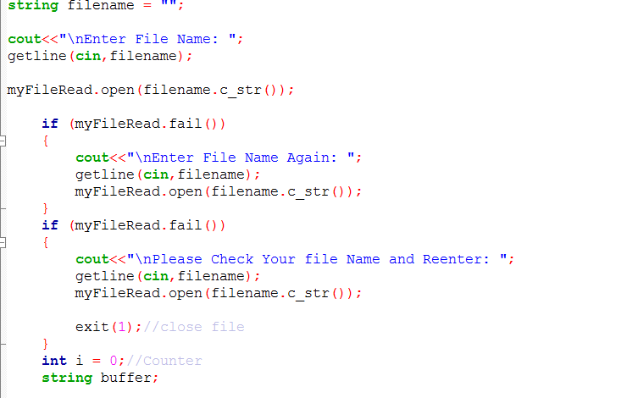
Assembler Function
Enter File name and check if is right
Gives user 3 chances to enter correct name

Slide 6
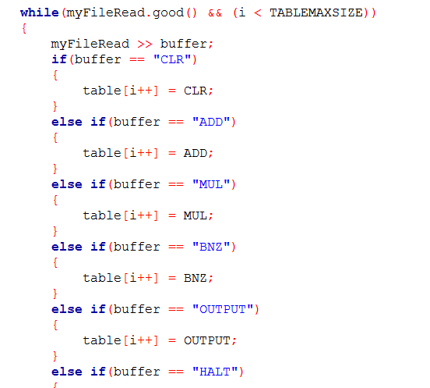
Takes each command and saves in
table
To later use it to create txt file

Slide 7
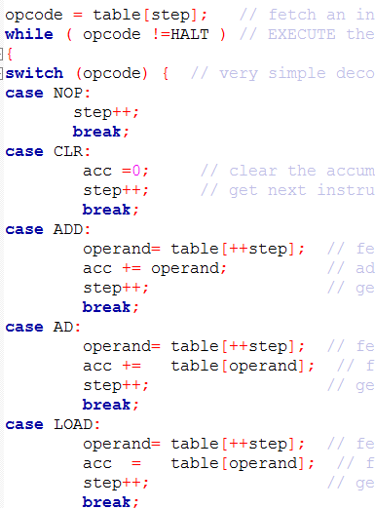
Virtual Machine Function
Use switch to run each command
We take each command from table
and run it one by one

